Slide 1
PYTHON FLOW CONTROL

Slide 2
PYTHON IF...ELSE STATEMENT
What is if...else statement in Python?
Decision making is required when we want to execute a code only if a certain condition is satisfied.
The if…elif…else statement is used in Python for decision making.
Python if Statement Syntax:
if test expression:
statement(s)

Slide 3
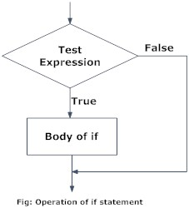
PYTHON IF STATEMENT FLOWCHART

Slide 4
EXAMPLE OF PYTHON IF STATEMENT
num = 3
if num > 0:
print(num, "is a positive number.")
print("This is always printed.")
num = -1
if num > 0:
print(num, "is a positive number.")
print("This is also always printed.")

Slide 5
PYTHON IF...ELSE STATEMENT
Syntax of if...else:
if test expression:
Body of if
else:
Body of else
The if..else statement evaluates test expression and will execute the body of if only when the test condition is True.
If the condition is False, the body of else is executed. Indentation is used to separate the blocks.

Slide 6
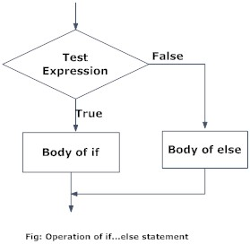
PYTHON IF..ELSE FLOWCHART

Slide 7
EXAMPLE OF IF...ELSE
num = 3
if num >= 0:
print("Positive or Zero")
else:
print("Negative number")

Slide 8
PYTHON IF...ELIF...ELSE STATEMENT
Syntax of if...elif...else:
if test expression:
Body of if
elif test expression:
Body of elif
else:
Body of else
The elif is short for else if. It allows us to check for multiple expressions.
If the condition for if is False, it checks the condition of the next elif block and so on If all the conditions are False, the body of else is executed.
Only one block among the several if...elif...else blocks is executed according to the condition.

Slide 9
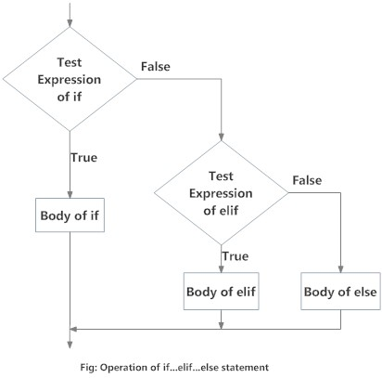
FLOWCHART OF IF...ELIF...ELSE

Slide 10
EXAMPLE OF IF...ELIF...ELSE
num = 3.4
if num > 0:
print("Positive number")
elif num == 0:
print("Zero")
else:
print("Negative number")

Slide 11
PYTHON NESTED IF STATEMENTS
We can have a if...elif...else statement inside another if...elif...else statement. This is called nesting in computer programming.
Any number of these statements can be nested inside one another. Indentation is the only way to figure out the level of nesting. They can get confusing, so they must be avoided unless necessary.

Slide 12
PYTHON NESTED IF EXAMPLE
num = float(input("Enter a number: "))
if num >= 0:
if num == 0:
print("Zero")
else:
print("Positive number")
else:
print("Negative number")

Slide 13
THANK YOU

